Slide 1
STATISTIC PROJECT
City - Bengaluru
Presented by,
Pranav Bansod
Suraj Shivakumar

Slide 2
City - Bengaluru
Location - Hebbal, Bengaluru (KSPCB)
Data : 1st January 2020 - 31st December 2020
No. of recorded data points : 61,140
Parameters recorded : CO, NO2, O3, PM10, PM2.5, SO2

Slide 3
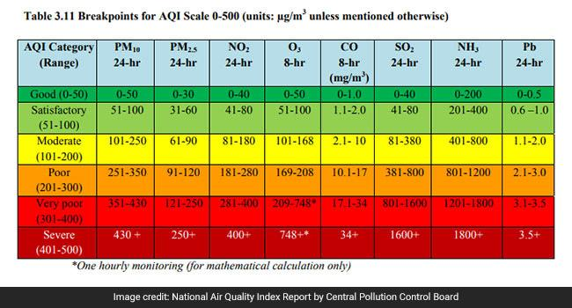
AQI Based on Category and Range

Slide 4
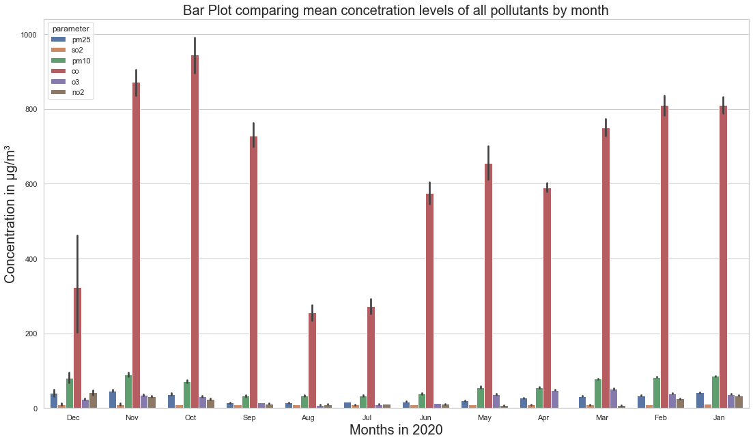
An Overview of pollution and its contents over all months in 2020

Slide 5
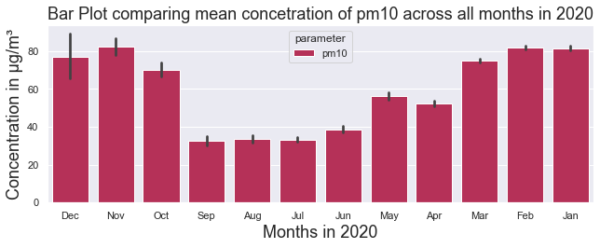
Amount of Pm10 present in atmosphere across all months

Slide 6
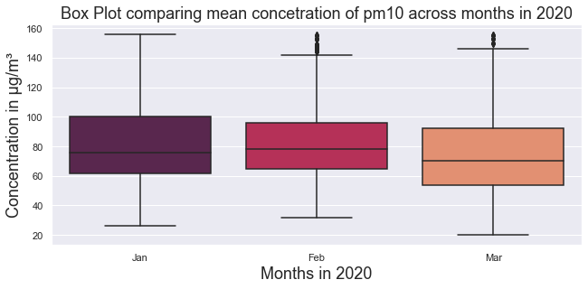
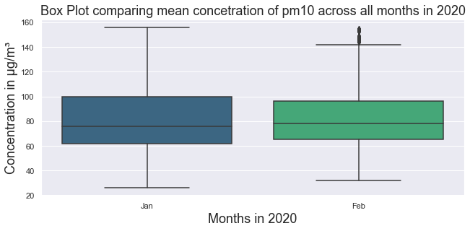
Hypothesis H0 :
Amount of Pm10 present in atmosphere for months (Jan, Feb, March) is same
Hypothesis H0:
Amount of Pm10 present in atmosphere for months (Jan & Feb) is same

Slide 7
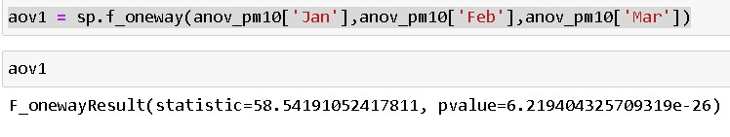
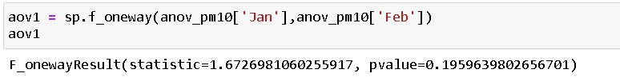
Since the p-value<0.005,
H0 is Rejected.
Since the p-value>0.005,
H0 is Accepted.
P-value = 0.00000000000000000000000006129
P-value = 0.1959

Slide 8
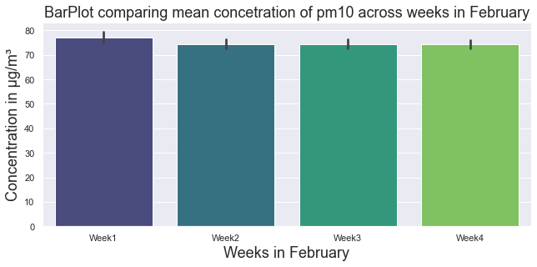
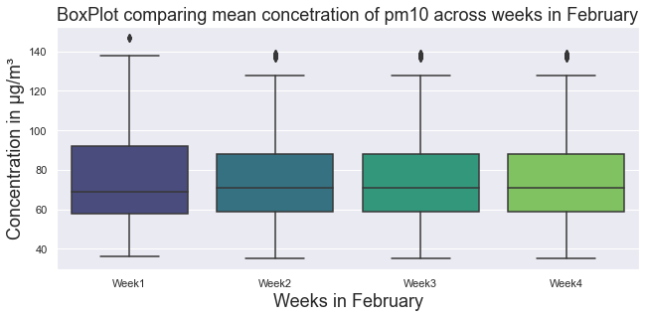
Hypothesis H0 :
Amount of Pm10 present in atmosphere across weeks of Feb is same

Slide 9
Since the p-value>0.005,
H0 is Accepted.
P-value = 0.1296

Slide 10
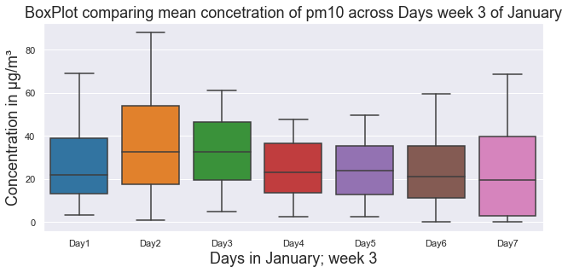
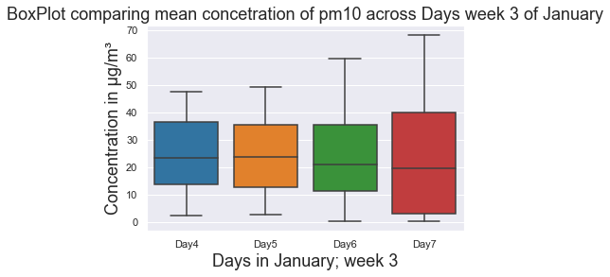
Hypothesis H0 :
Amount of CO present in atmosphere across Days in 3rd week of Jan is same
Hypothesis H0 :
Amount of CO present in atmosphere across Days(4,5,6,7) in 3rd week of Jan is same

Slide 11
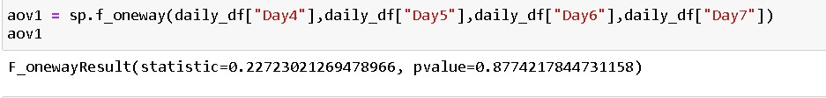
Since the p-value<0.005,
H0 is Rejected.
Since the p-value>0.005,
H0 is Accepted.
P-value = 0.00001036
P-value = 0.8774

Slide 12
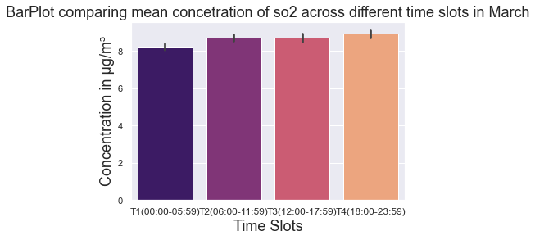
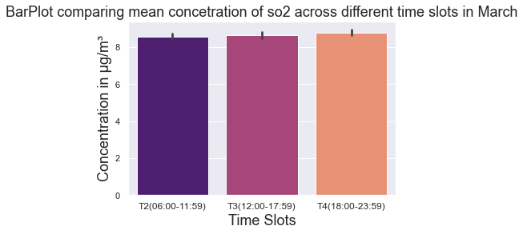
Hypothesis H0 :
Amount of Pm10 present in atmosphere for time periods(T1,T2,T3,T4) for the month of Jan is same
Hypothesis H0 :
Amount of Pm10 present in atmosphere for time periods(T2,T3,T4) for the month of Jan is same

Slide 13
Since the p-value<0.005,
H0 is Rejected.
Since the p-value>0.005,
H0 is Accepted.
P-value = 0.00001103
P-value = 0.2717

Slide 14
Conclusion
Amount of Pm10 present in atmosphere for months (Jan, Feb, March) is not same.
Amount of Pm10 present in atmosphere for months (Jan, Feb) is same.
Amount of Pm10 present in atmosphere for weeks of Feb is same.
Amount of CO present in atmosphere across Days in 3rd week of Jan is not same.
Amount of CO present in atmosphere across Days(4,5,6,7) in 3rd week of Jan is same.
Amount of Pm10 present in atmosphere for time periods(T1,T2,T3,T4) for the month of Jan is not same.
Amount of Pm10 present in atmosphere for time periods(T2,T3,T4) for the month of Jan is same.

Slide 15
THANK YOU

